Slide 1
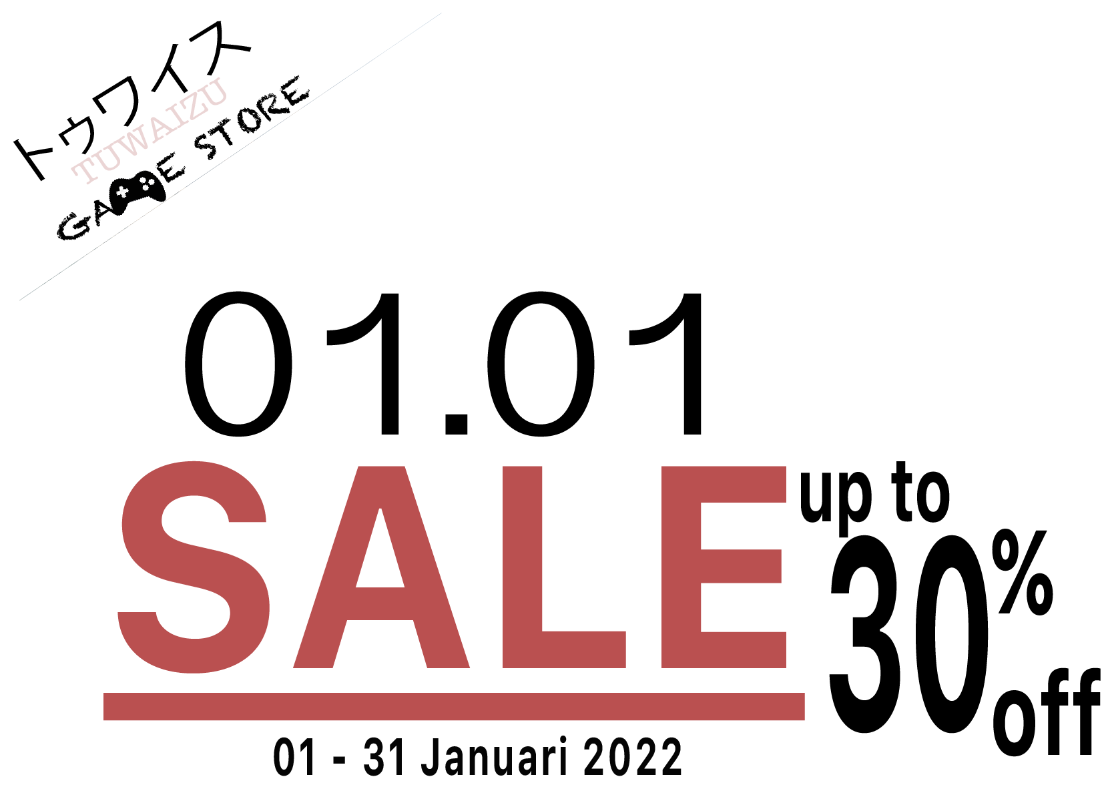
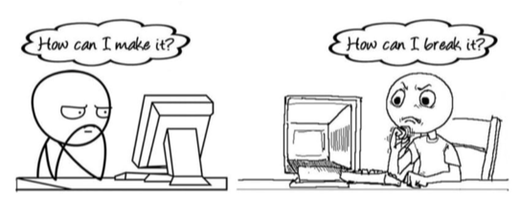
FINAL PROJECT
Gamestore App Backend Development
<Joelio>
As Developer
<Rudi>
As Tester

Slide 2
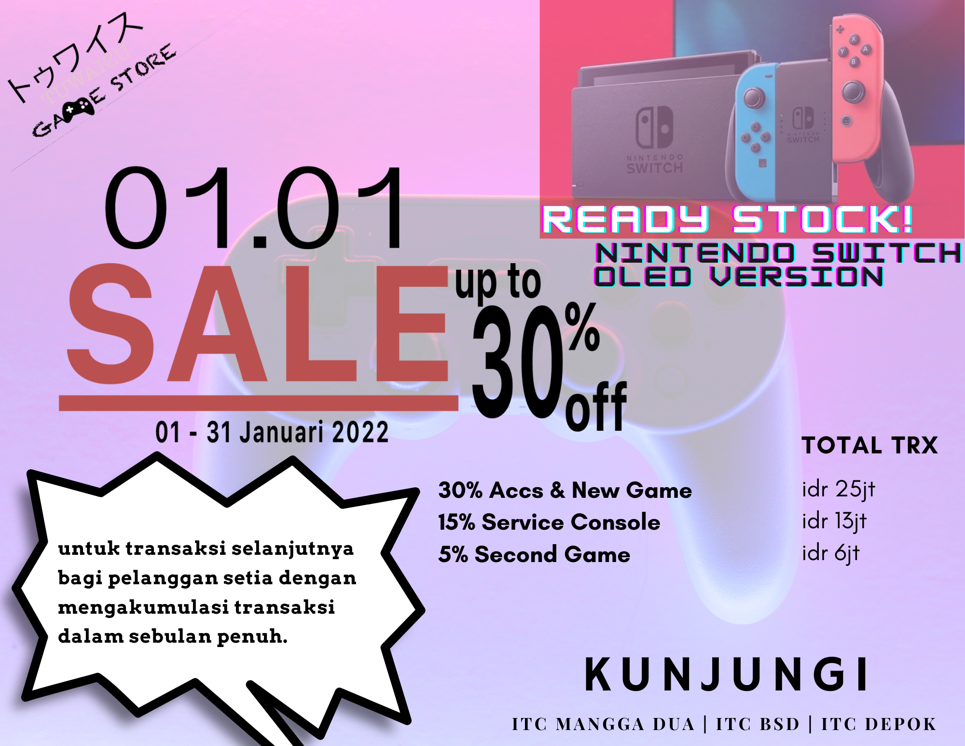
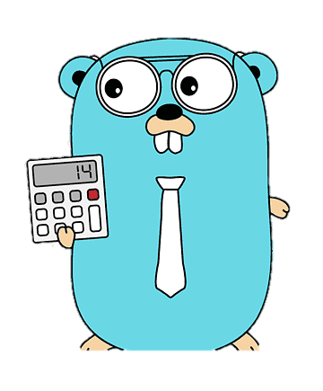

LATAR BELAKANG

Slide 3
Mengapa golang?
Development yang lebih scalable
Dapat membangun sistem dengan kinerja tinggi dan kompleks
Aman
Struktur data dan algoritma yang mudah dipelajari
Error yang mudah untuk ditelusuri
Memiliki fitur seperti GoRoutine, garbage collection dan concurrency.

Slide 4
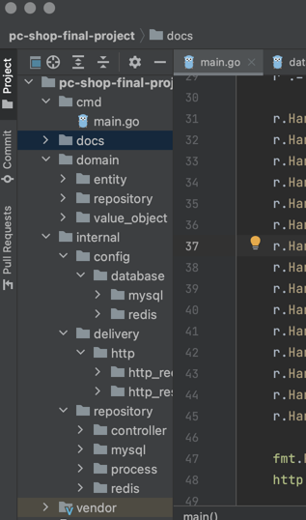
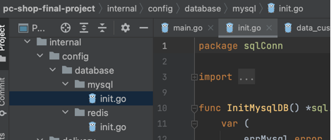
Mengapa KAMI?
Menggunakan Clean Architecture dan source code yang mudah dimengerti.
Menggunakan Test Driven Development dan dapat melacak error dengan mudah.
Dapat dikerjakan remote
Full support 7/24
Biaya yang terjangkau
Menggunakan private entity yang lebih aman, caching strategy dan RDBMS yang mudah dikonfigurasi.

Slide 5







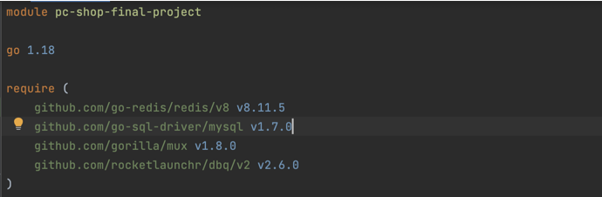
PERALATAN
Go 1.19
VSCode atau GoLand
Github
MySQL
Redis
Postman
Library

Slide 6
WORK FLOW
New users
New Customers
New Inventories
New Item Purchased
New Settlement
Generate Coupon
OWNER
EMPLOYEE
List Transaction
List Coupon

Slide 7

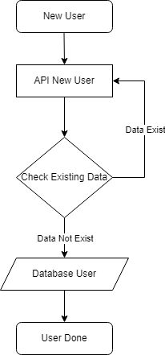
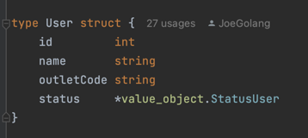
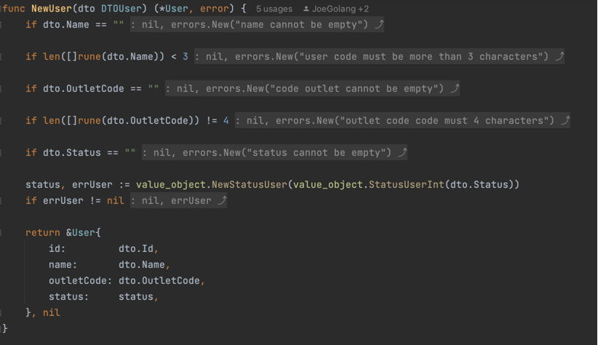
New users
Notes:
Consider talking about:
Producer
Publisher
Development team

Slide 8
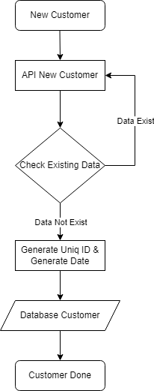

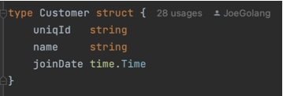
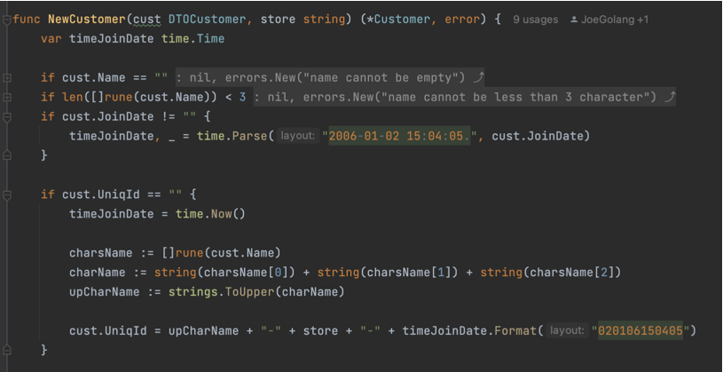
New customerS
Notes:
Consider talking about:
Producer
Publisher
Development team

Slide 9
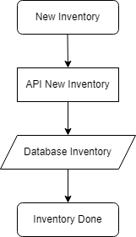

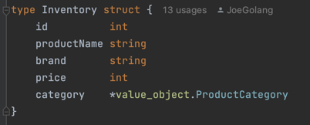
NEW INVENTORIES
Notes:
Consider talking about:
Producer
Publisher
Development team

Slide 10
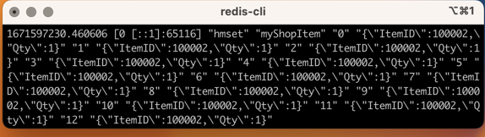

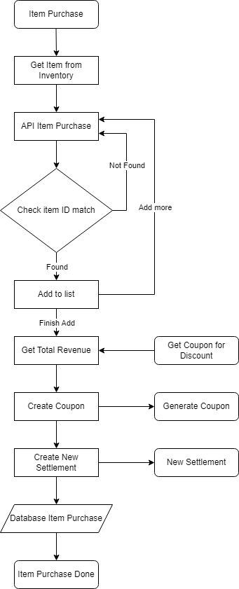
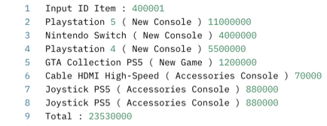
New ITEM PURCHASED
Notes:
Consider talking about:
Producer
Publisher
Development team

Slide 11
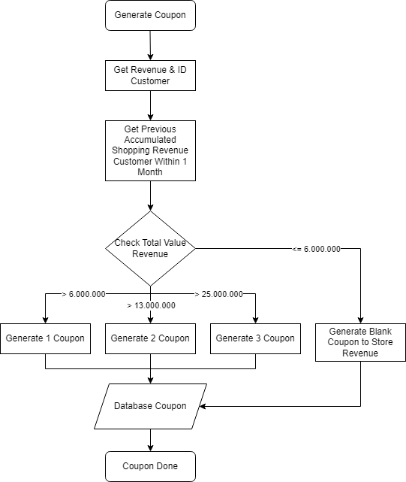
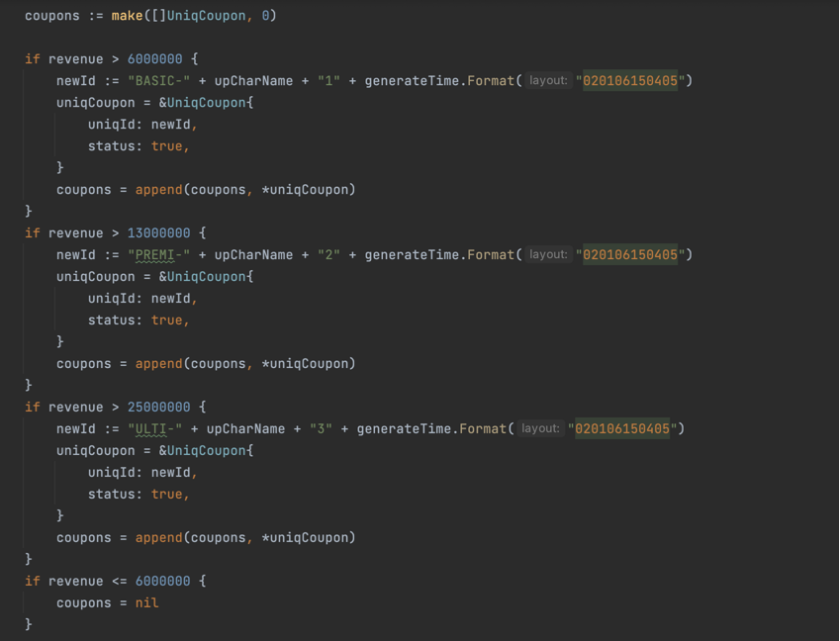

GENERATE COUPON
Notes:
Consider talking about:
Producer
Publisher
Development team

Slide 12

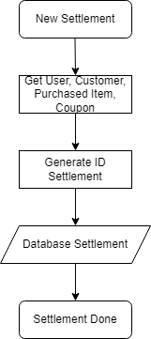
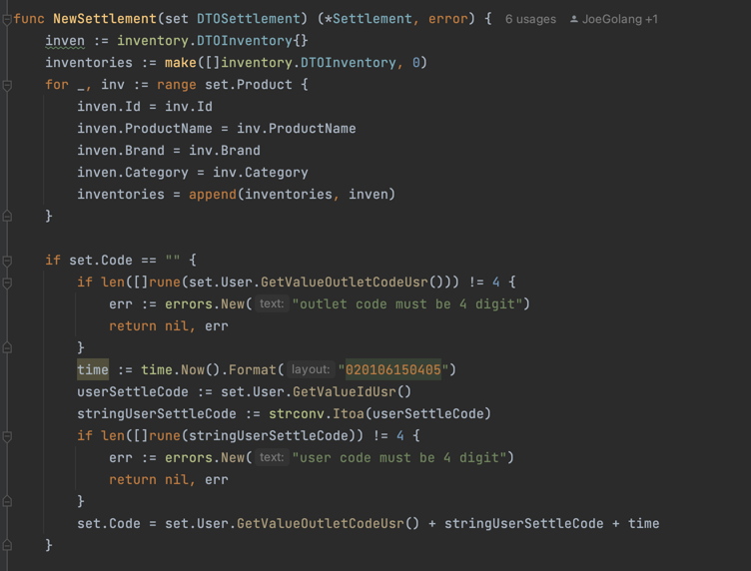
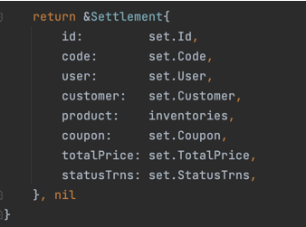
New SETTLEMENT
Notes:
Consider talking about:
Producer
Publisher
Development team

Slide 13

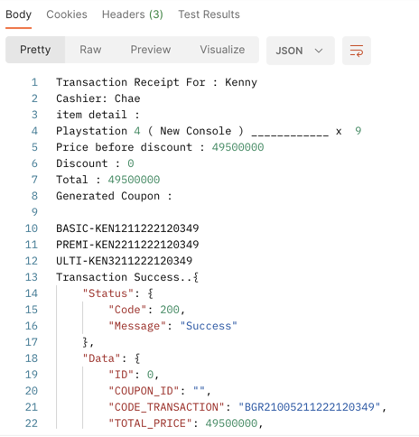
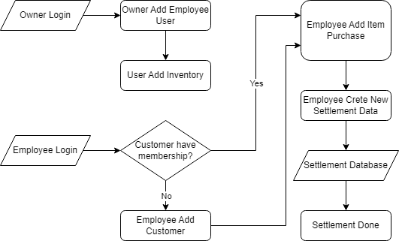
PROCESS SETTLEMENT
Notes:
Consider talking about:
Producer
Publisher
Development team

Slide 14
DEMO < > c o d e

Slide 15
SEKIAN & TERIMAKASIH

